Slide 1
Blockchain & Digital Transformation
By: Gheis Mohammadi

Slide 2
Agenda
History of Blockchain
Centralized and Decentralized Networks
Basic Concept of Blockchain
Blockchain Platforms
Basic Concept of Crypto Currencies
Digital Transformation and Blockchain Applications
Markets & Jobs
Future

Slide 3
Introduction
Background

Slide 4
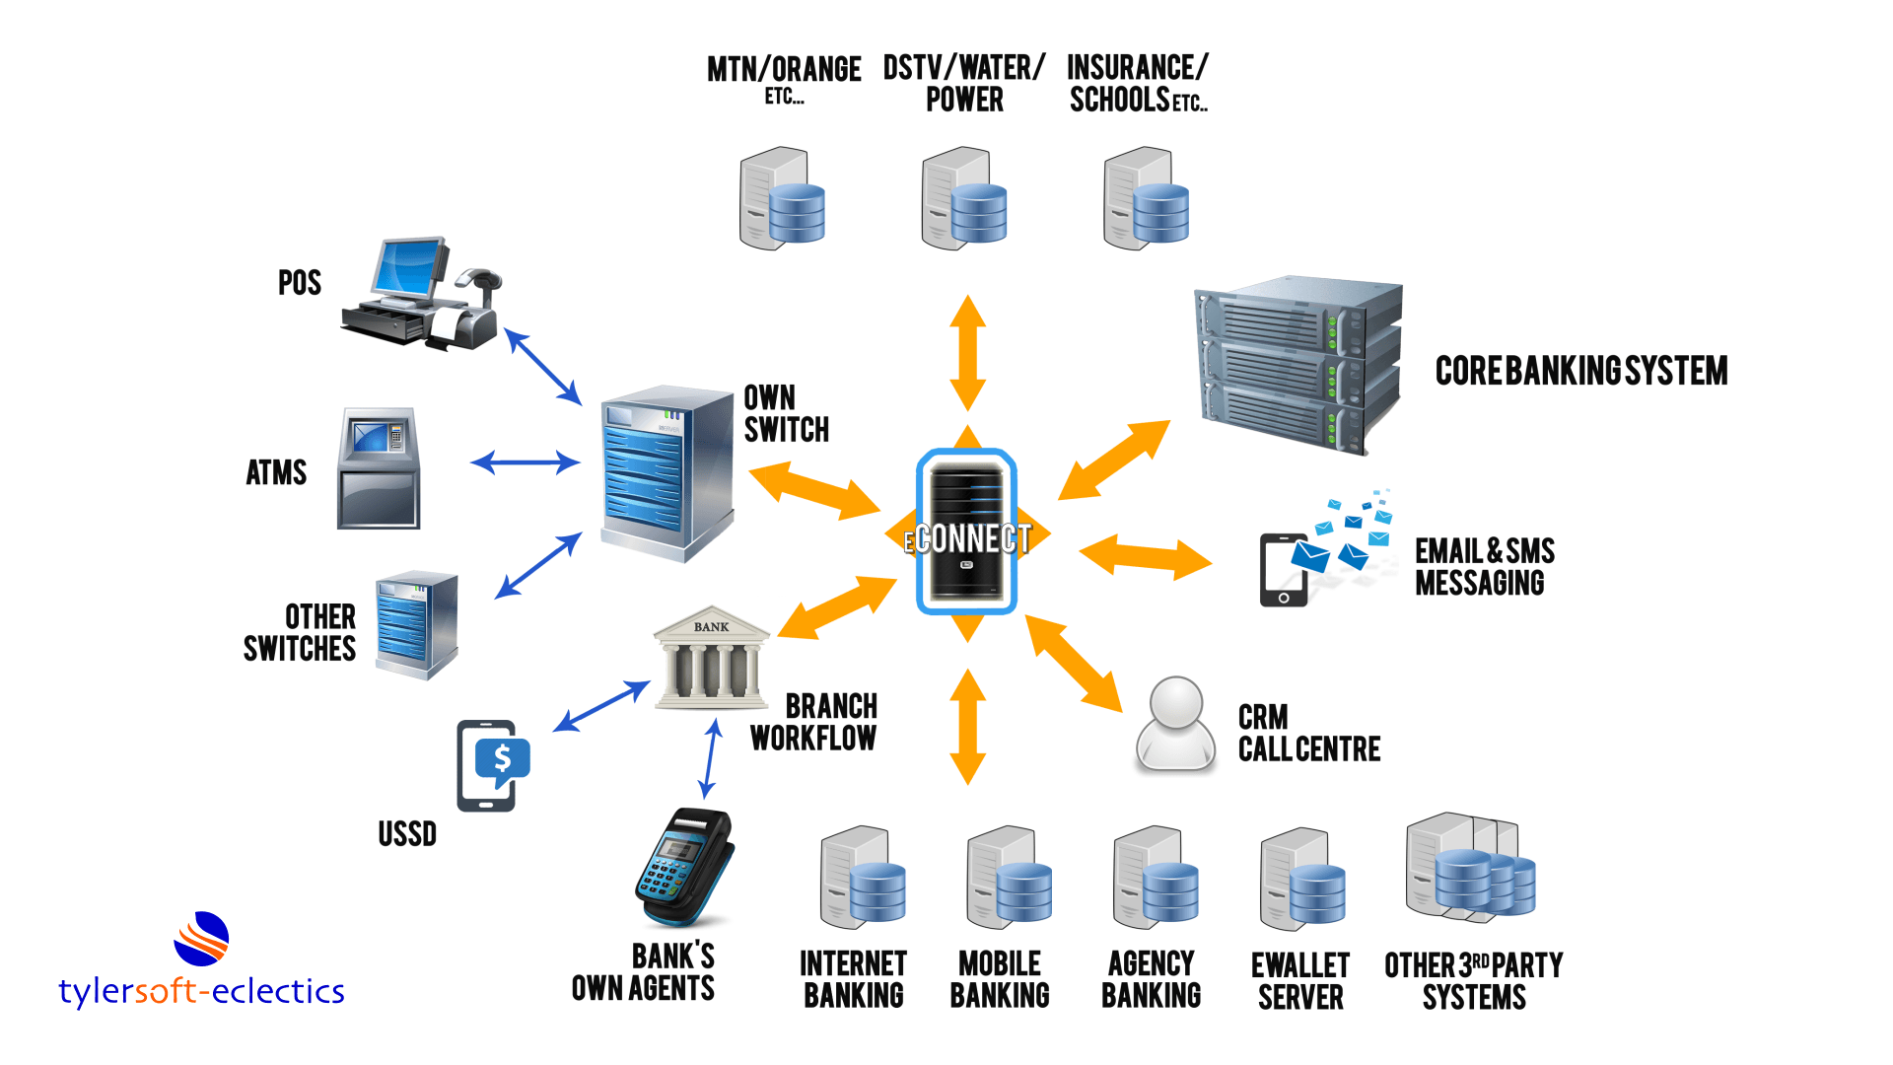
Traditional Banking

Slide 5
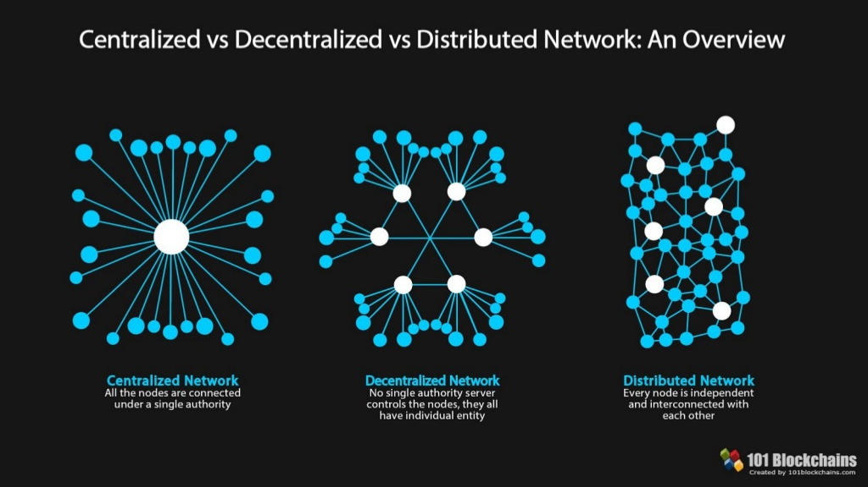

Slide 6
Bitcoin Key Highlights
October 31, 2008: Bitcoin white paper published by the anonymous Satoshi Nakamoto.
January 3, 2009: The Genesis Block or block number one is mined.
January 12, 2009: The first Bitcoin transaction.
December 16, 2009: Version 0.2 is released.
November 6, 2010: Market cap value exceeds $1 million USD.
June 3, 2012: Block 181919 created with 1322 transactions. It is the largest block to-date.
September 27, 2012: Bitcoin Foundation is formed.
December 2017: Bitcoin price reaches its all-time high.
October 31, 2018: 10-year anniversary of Bitcoin.

Slide 7
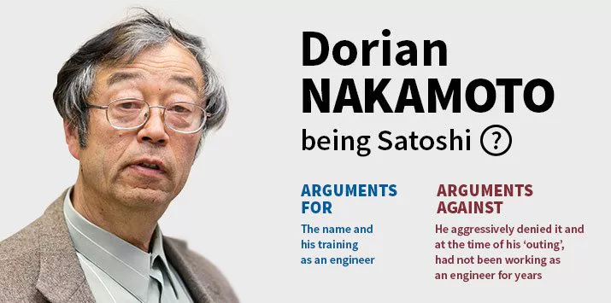
Satoshi Nakamoto

Slide 8
What is Blockchain?
Open, Distributed ledger that can record transactions between two parties efficiently and in a verifiable and permanent way
Permanent and Immutable
Transparent
Trustable
Transactions (Irreversible/Pseudonymous/Fast and global/Secure/Permissionless)

Slide 9
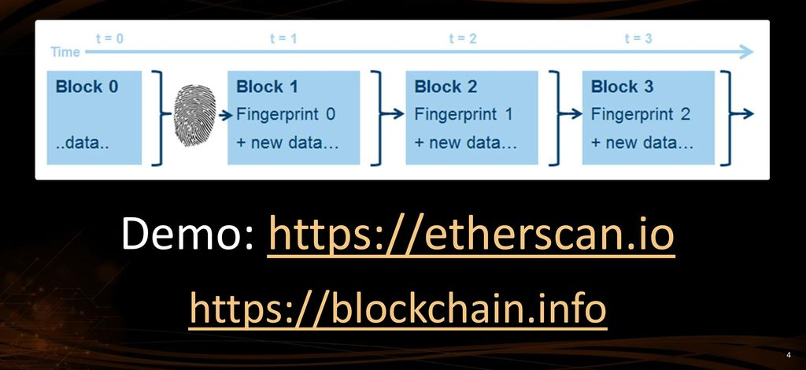
Blockchain == Chain of Blocks

Slide 10
CRYPTOGRAPHY
Converting data into a format that is unreadable for an unauthorized user
In Blockchains:
Initiation and Broadcasting of Transaction
- Digital Signatures
- Private/Public Keys
Validation of Transaction
- Proof of Work and certain alternatives
Chaining Blocks
- Hash Function

Slide 11
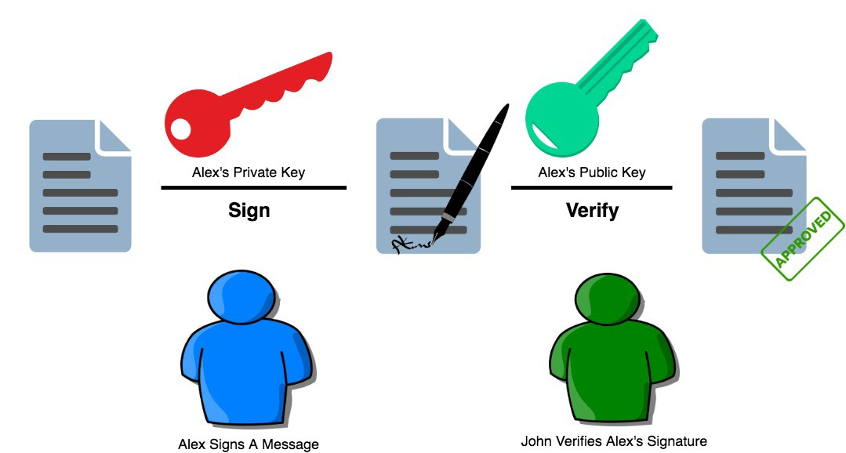
Digital Signature

Slide 12
Mining
Bitcoin miners are nodes in the Bitcoin network that possess specialized software technology called ASICs.
The Bitcoin miners constantly solve crypto graphically hard puzzles.
If successful, they get to add a block to the Bitcoin blockchain and get a reward, in return.
Currently, the bitcoin block reward is around 12.5 BTC.

Slide 13
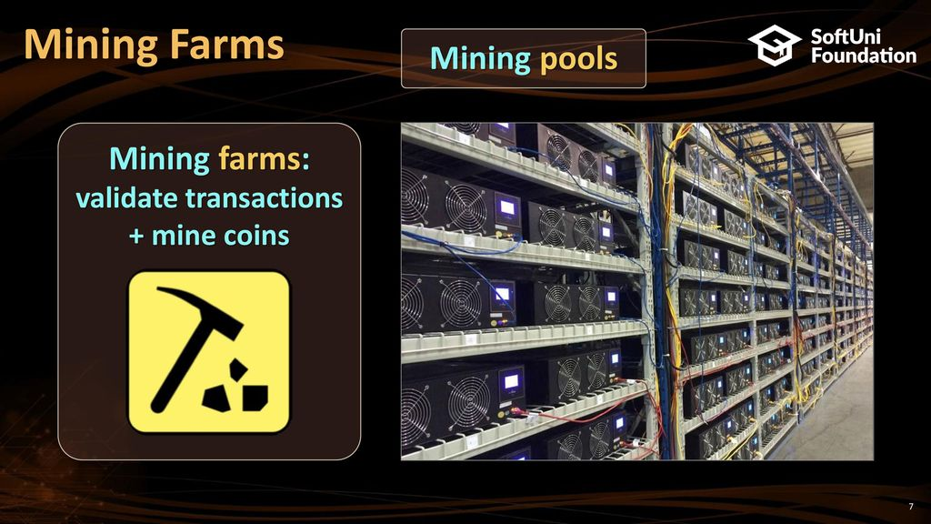

Slide 14
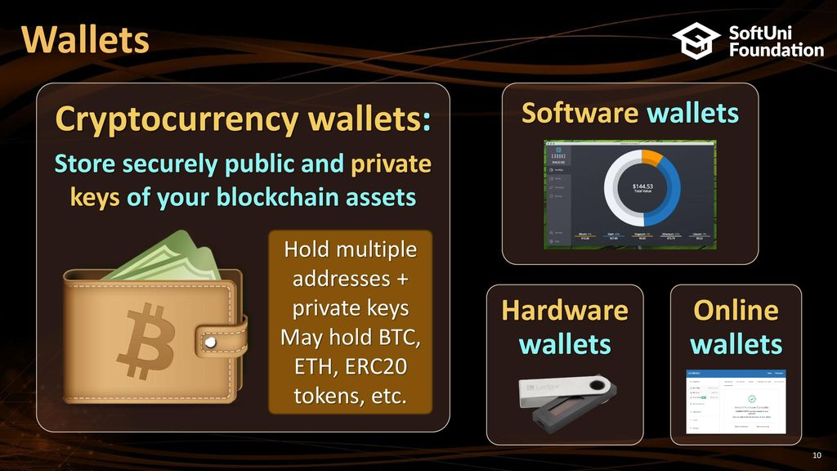

Slide 15
Characteristics
“White papers” often address key questions
Public Blockchains vs Private Blockchains
Permissioned vs Permissionless
One ledger or Segregated ledgers
Validation Methodology (depends on degree of trust between nodes.)
Consensus Mechanism (depends on degree of trust between nodes)
Interfaces/programming language
Supporting Smart Contracts

Slide 16
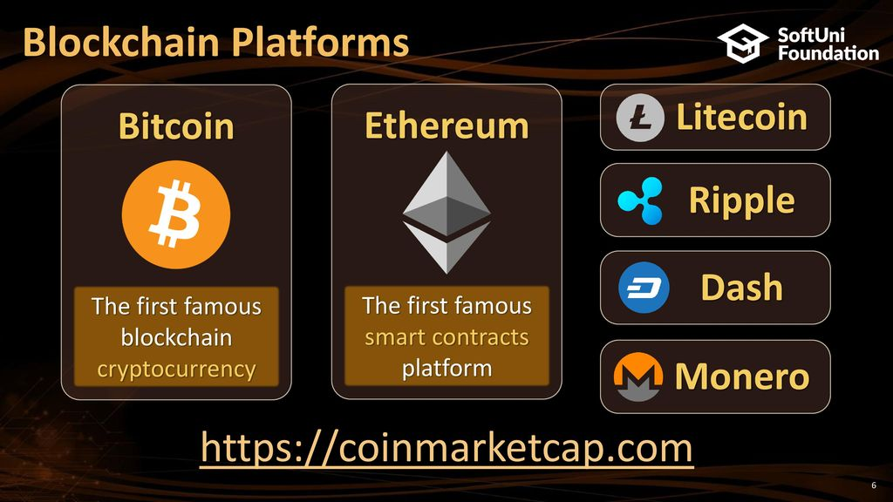

Slide 17
Leading Blockchain Consortiums and Collaborative Projects

Slide 18
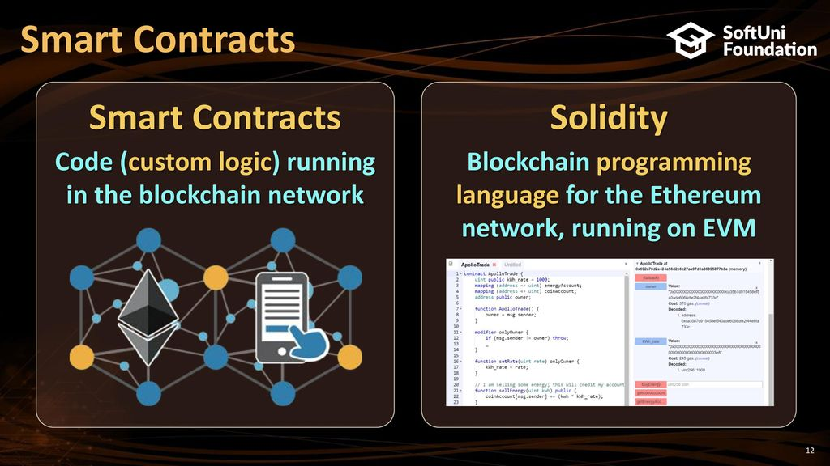

Slide 19
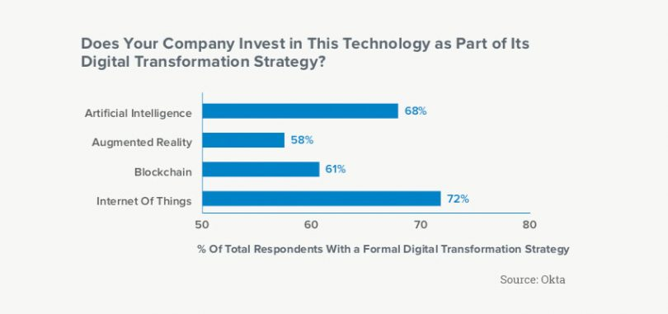
Digital Transformation

Slide 20
Digital Transformation & Blockchain
Blockchain is part of digital transformation strategy for 61% of enterprises
By 2021, at least 25% of the global 2000 will use blockchain services as a foundation for digital trust at scale
Nearly 6 in 10 large corporations are either actively considering, or are in the process of, deploying blockchain technology
Blockchain have many potential applications rather than financial services industry
Zero Trust

Slide 21
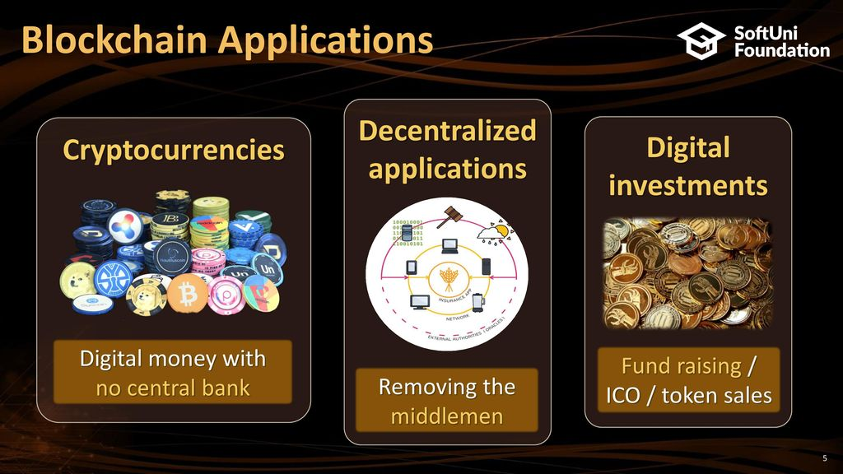
Applications

Slide 22
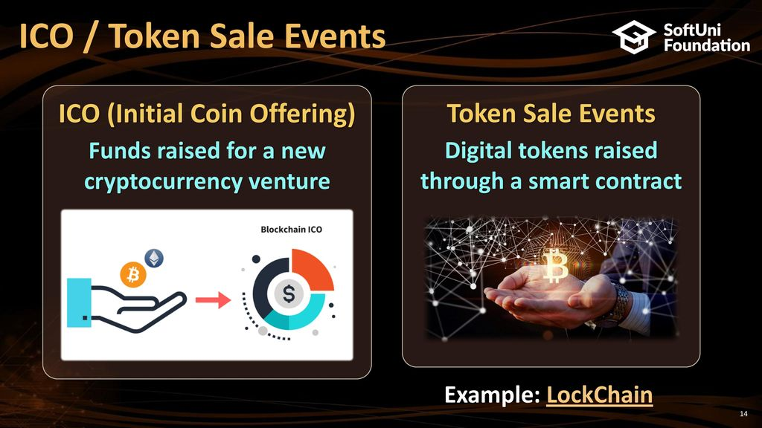

Slide 23
High Demand Markets
Supply Chains
Education
Healthcare
Insurance
IOT
Investing
Digital Assets & Bonds
Digital Banking & Payments
Game Industry
Data Management

Slide 24
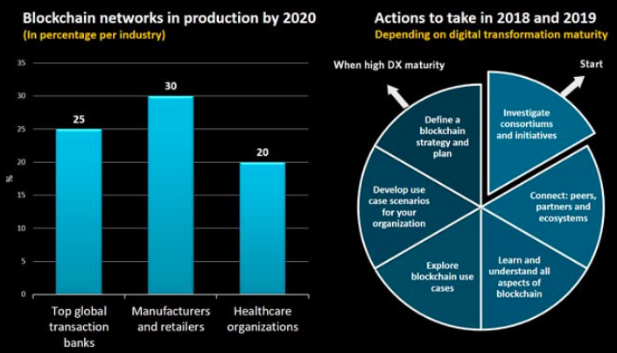
Blockchain in Production

Slide 25

Negatives
Dark Web / Drugs / Gambling / Money Laundering
CryptoKitties
CryptoKitties is a game,
collectible!
Each cat is one-of-a-kind and 100% owned by you;
it cannot be replicated, taken away, or destroyed.
Market Cap: $20M in 2018

Slide 26
Blockchain Jobs
Startup (?)
Developer & Engineer ($135,000 - $185,000 per year)
Core developer
Tools
DApps & Smart Contracts
Adviser ($56,000 – $107,000 per year)
Solution & Designer (?)

Slide 27
High Salaries
Increased demand and short supply
Technology is on everyone’s radar
Established firms have embraced blockchain and announced initiatives
Microsoft Corp. (MSFT) has started a blockchain-as-a-service (BAAS) platform within Azure, its cloud division
IBM Corp. (IBM) has also launched a division dedicated to blockchain, basing it on an open-source fabric Hyperledger.
Social media behemoth Facebook Inc. (FB) has formed a group to explore blockchain’s uses in its business.
Nike now holds patent for blockchain-based sneakers called ‘CryptoKicks’
A shortage in skills supply has helped further inflate salaries for blockchain experts.
Several new initiatives are being launched to plug the gap in supply, from bounty programs to encourage developers to boot camps introducing the technology to developers.
Universities are also in on the game and have launched online courses to educate professionals.

Slide 28
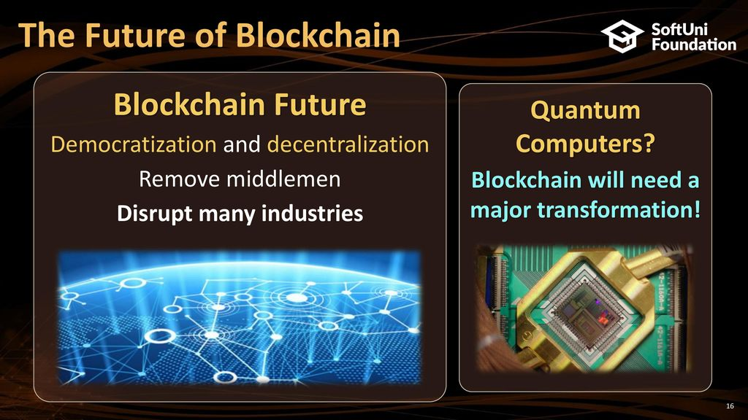

Slide 29


